Slide 1
IMDB DATASET ANALYSIS ADVANCED SQL PROJECT
PRESENTED BY,
VEENA SRI PM,
DATA ANALYTICS AND DATA SCIENCE,
RP-33,
04-03-2025.

Slide 2
OBJECTIVE
To examine data from IMDB movie dataset and emphasize vital SQL concepts to perform data-driven operations using SQL query, supporting in decision-making, research and extract valuable information to generate meaningful insights to identify anomalies with deeper understanding of concepts.
AIM
Emphasize key SQL concepts such as joins, aggregation, filtering, and grouping.
Analyze and extract meaningful insights from a real-world movie dataset.

Slide 3
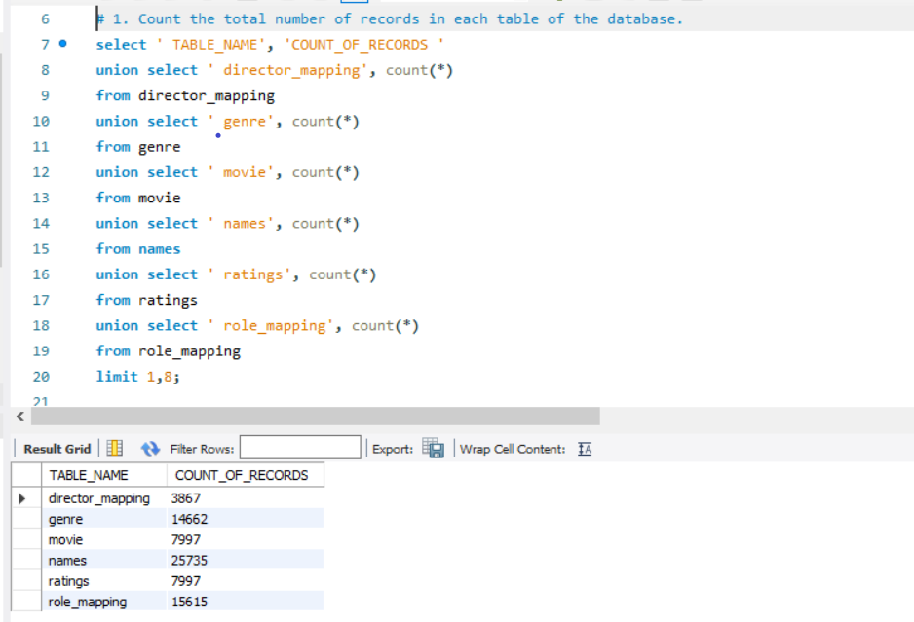
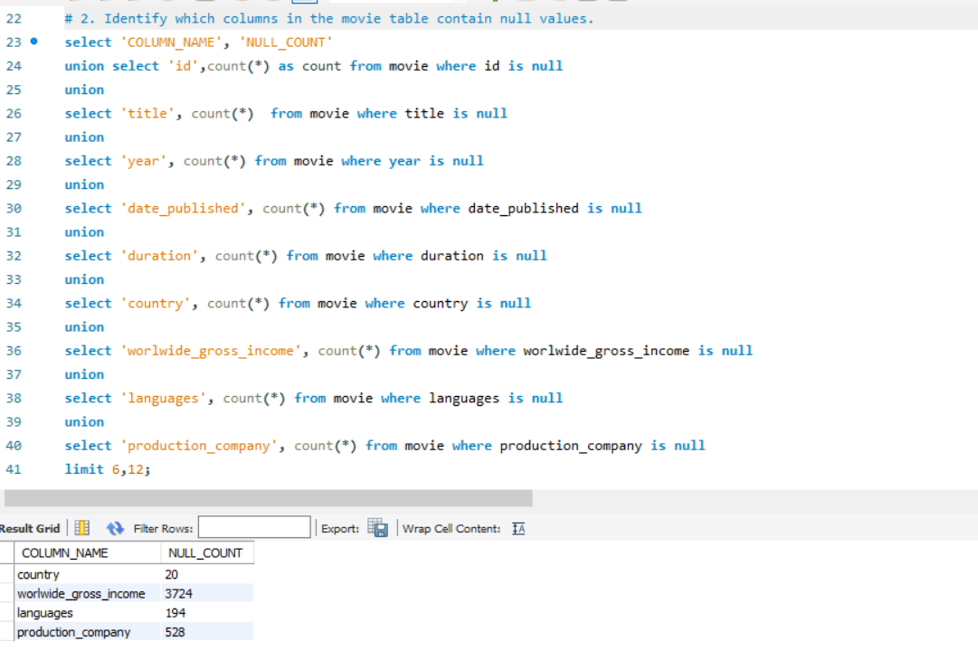
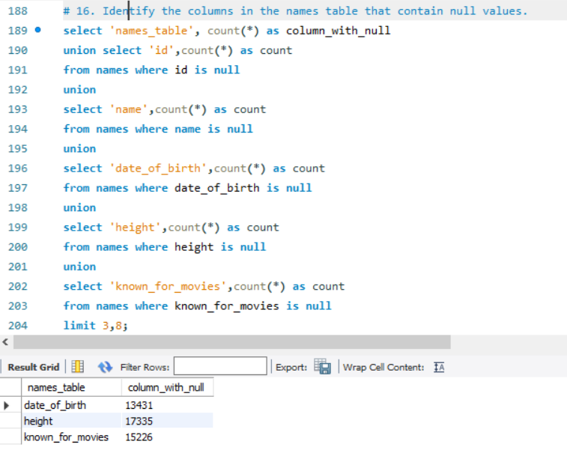
DATA COLLECTION
Movie- Title, Year, Production-company, Income, Language, Duration, Country.
Genre- Genres associated with each movie.
Director-Mapping- Maps movies to their Directors.
Role Mapping: Maps actors /actresses to movies.
Names- Information about people.
Ratings: Contains ratings information for movies, including the average rating, total votes, and median rating.

Slide 4
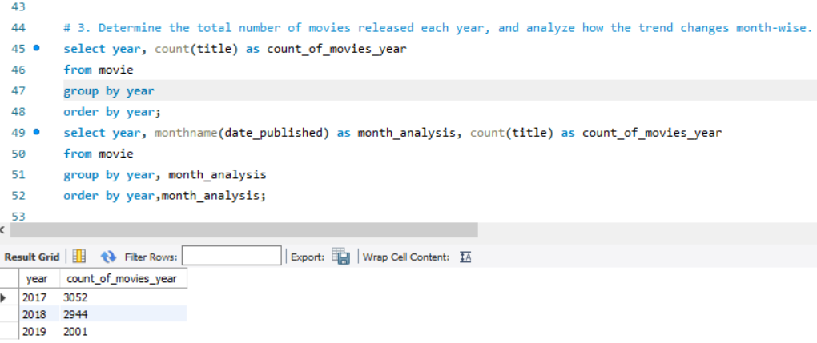
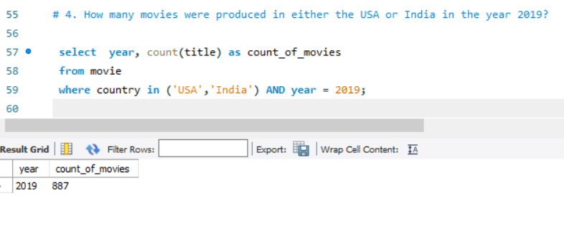
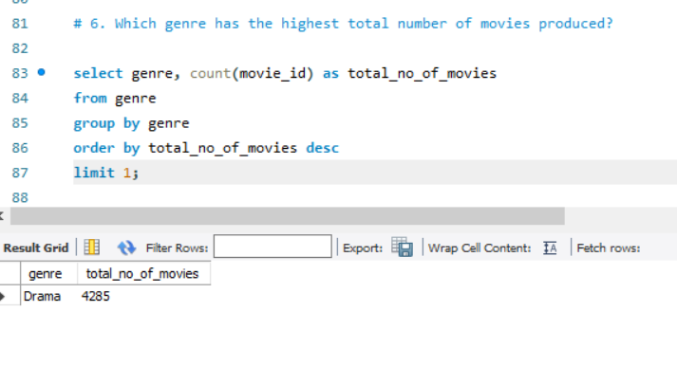
PATTERNS ANALYSIS
In Year 2017, September has highest count of 327 movies and July has lowest count of 188 movies produced.
In Year 2018, January has highest count of 302 and July has lowest count of 167 movies produced.
In Year 2019, September has highest count of 327 movies and July has lowest count of 188 movies produced.
Action and drama are most preferred genre.

Slide 5
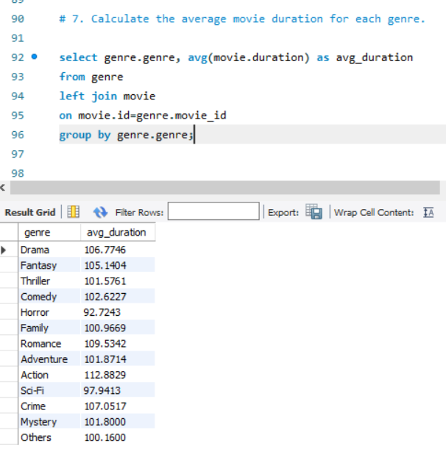
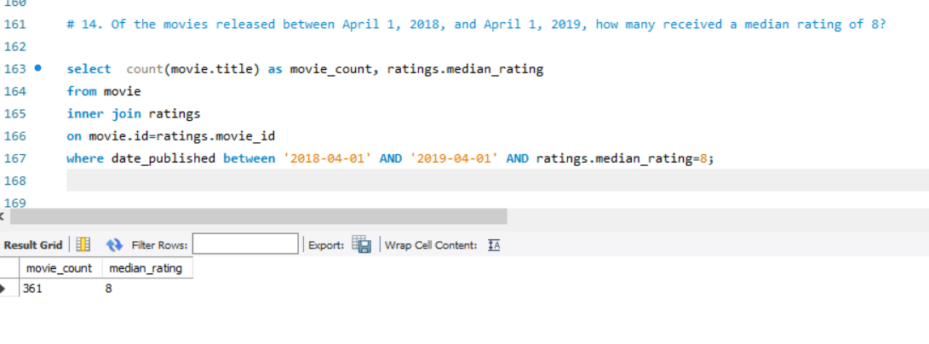
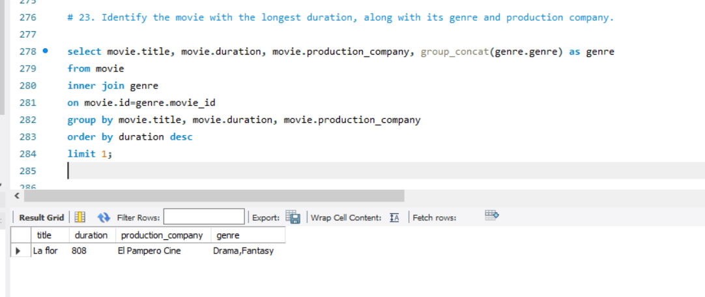
PERFORMANCE ANALYSIS
Movies produced in 2018 had a significant fall from January to July.
Drama and fantasy genre share same duration.

Slide 6
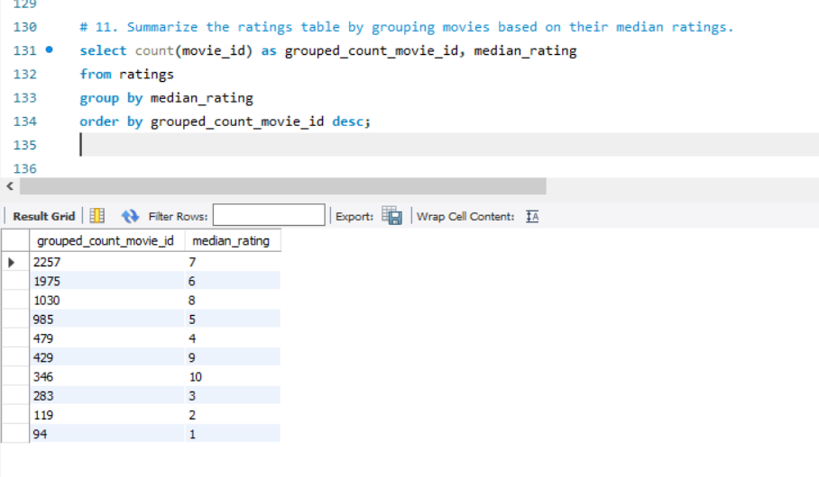
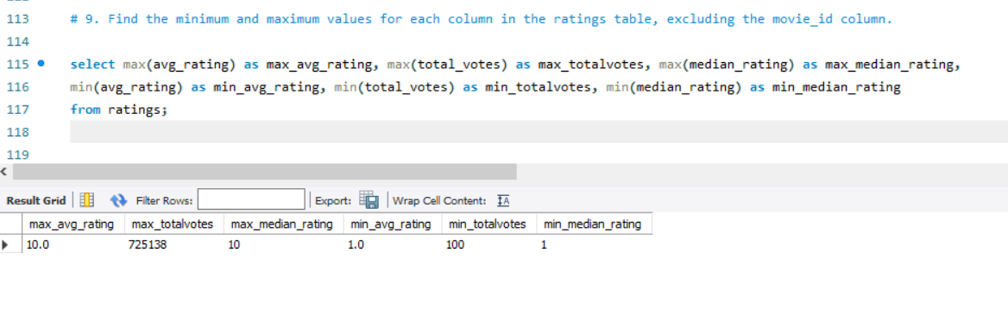
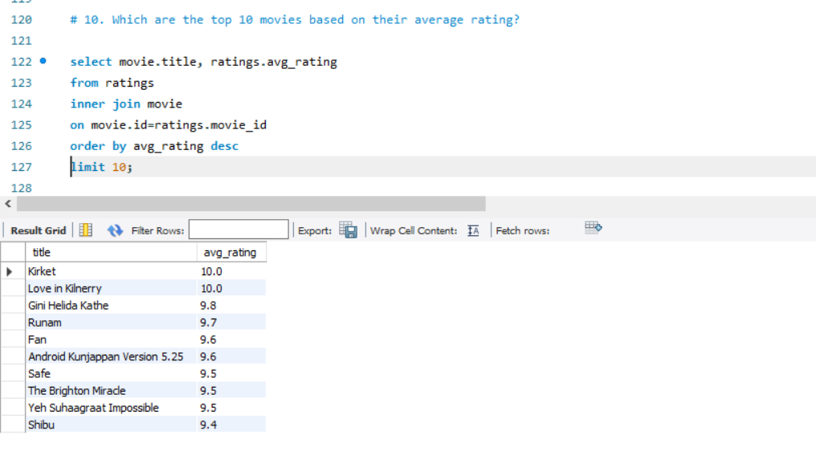
ANALYSIS ON RATINGS
Famed actor/ actress maintain ratings higher.
Ratings help understand and work on preferred genre.

Slide 7
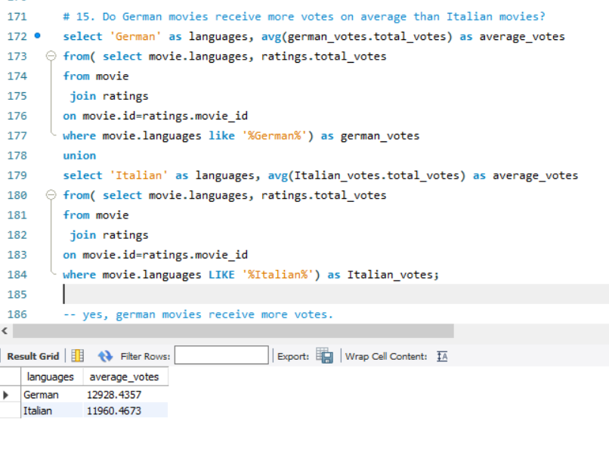
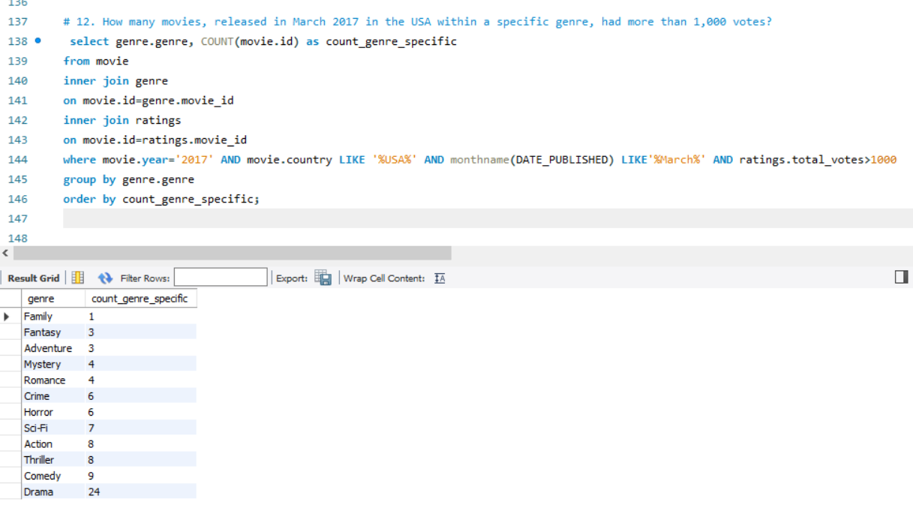
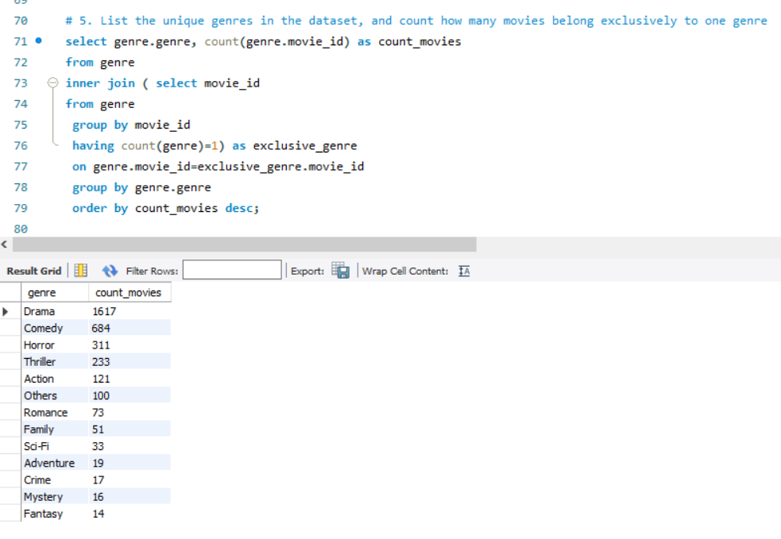
PREFERENCE TRENDS
Genre-drama lead over from other genres .
German language movies receive more votes on average than Italian language movies.

Slide 8
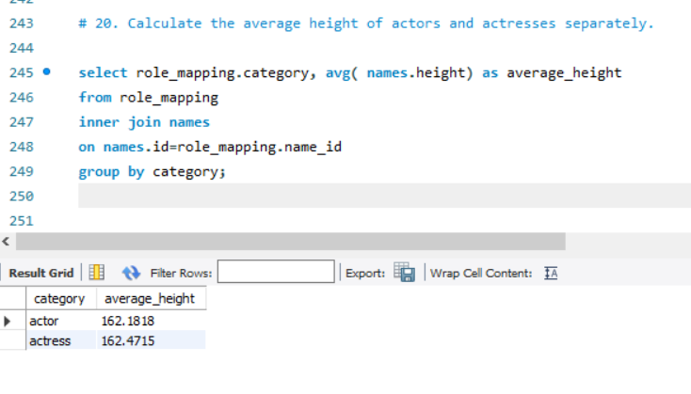
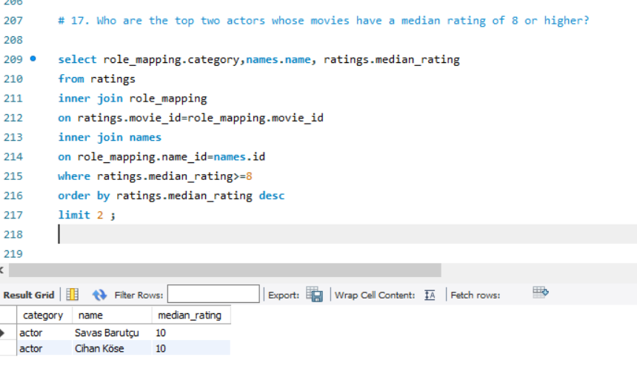
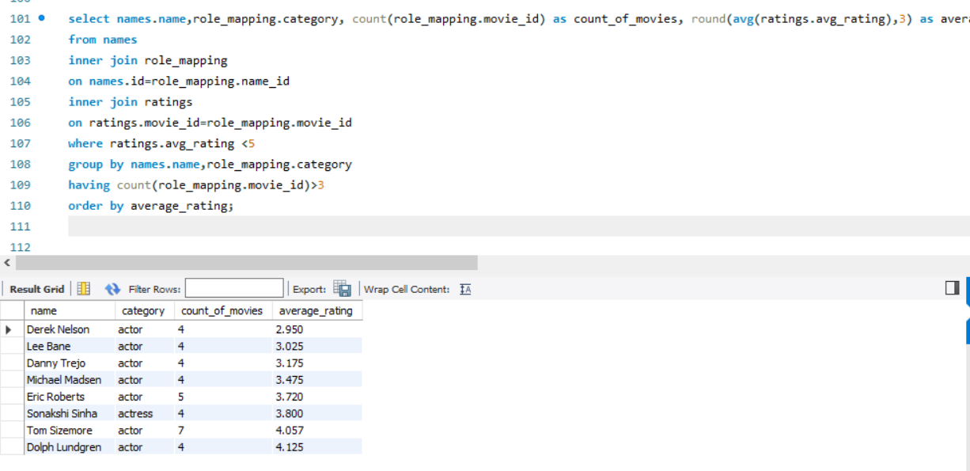
CREW PERFORMANCE
Consistency of performers impact ratings, eight actors have rating belove 5 and appeared more than 3 movies.
Highest median-ratings are maintained by reputed actor-actress.

Slide 9
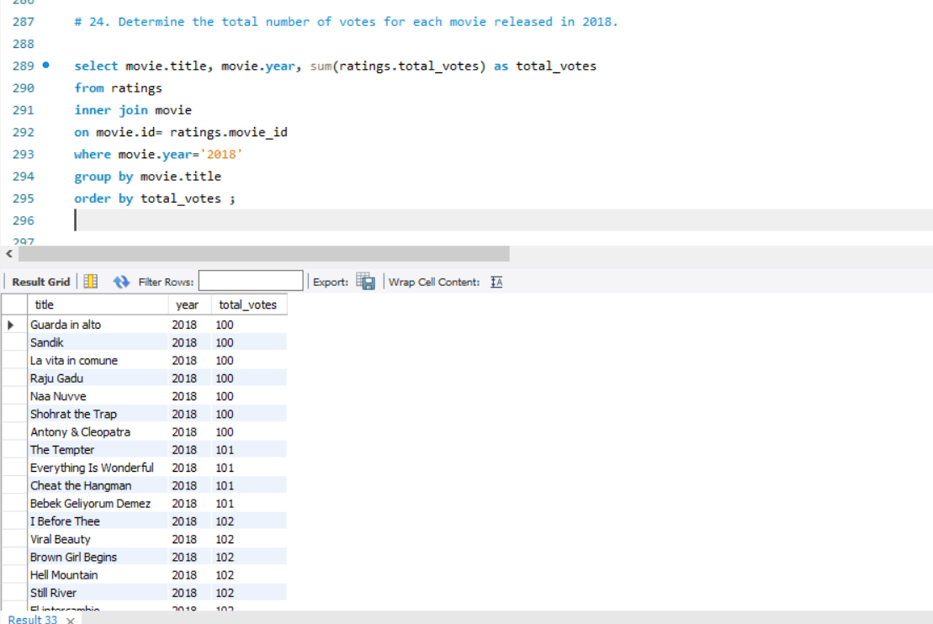
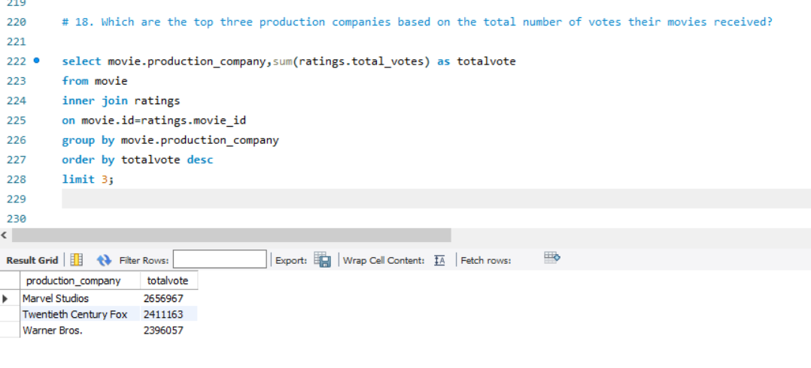
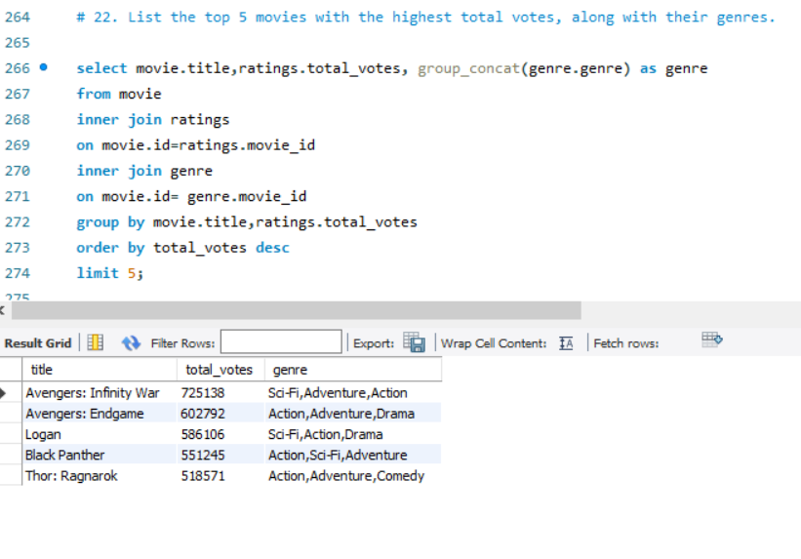
AUDIENCE PREFERENCE
Critics and journalists create controversies, topic widely discussed.
International movies receive more audience.
Marvel studios gain top votes.

Slide 10
FUTURE RECOMMENDATION
Target Marketing Campaigns to engage viewer’s
Optimization of new Ideas and Genre
Website Enhancement to enhance Interaction
Customer Retention Strategies.

Slide 11
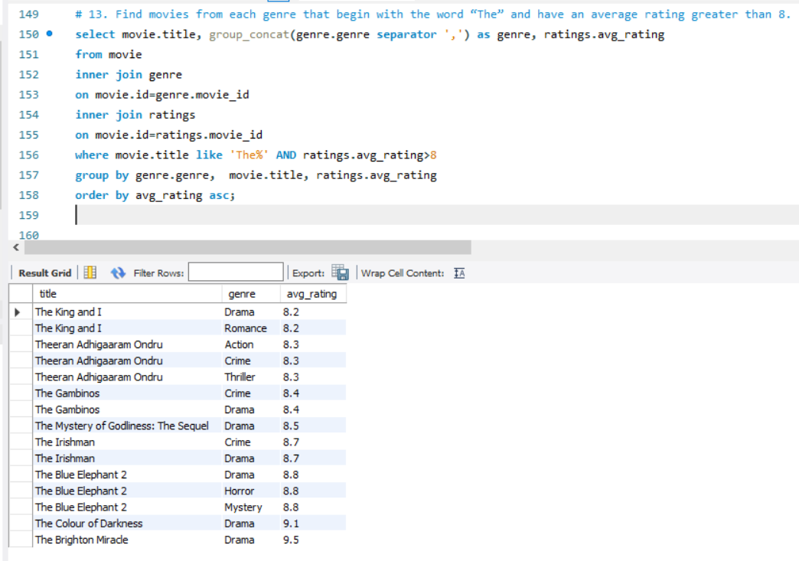
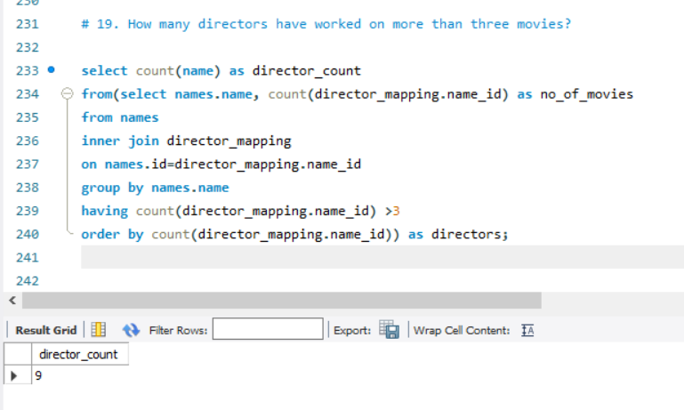
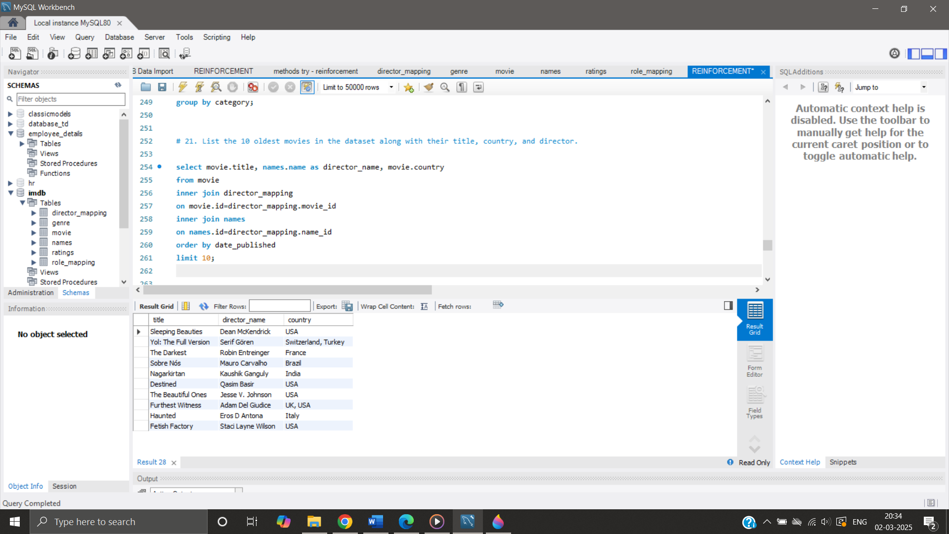
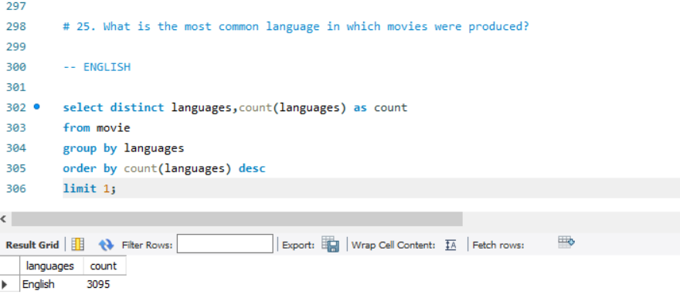
QUERIES

Slide 12

CONCLUSION
The IMDB movie dataset analysis provides valuable insights on year-month analysis, viewer’s interests based on ratings, genre most preferred and movie performance along with preferred actor-actress and language, which can be used to inform future business strategies and decision-making by leveraging these findings, company improves customer satisfaction, increase enthusiasts/ viewers and optimize operations.

